Slide 1

What are we going to see in this session?
Strategies
Forks
Error Handling
Ansible Vault

Slide 2
Strategy
[Example running playbook on 10 machines]
Linear ( default ansible strategy )
Executes tasks linearly on all servers parallel.
Free
Each server runs all of its task independent of other servers, it does not wait for the other server.
strategy : free
Batch (based on linear)
This is used to execute in batch linearly, we use
serial : 3
Here 3 servers are executed and finishes first then ansible triggers the rest of the servers. We can also specify % example (30%) instead of count.

Slide 3
Forks
This is used to define parallel process of execution on remote hosts.
Default Forks is 5 ( defined in ansible.cfg )
forks=5
Can be defined on a play using ( -f ) argument.

Slide 4
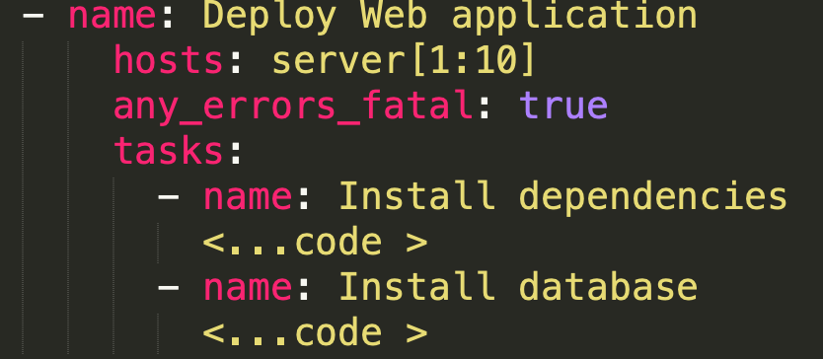
Error handling
any_errors_fatal : true
If any task fails on one server
ansible will stops the execution on all servers.
ignore_errors: yes
If any task fails and if that failure is not going to harm the overall play, we can skip the error using ignore_errors.

Slide 5
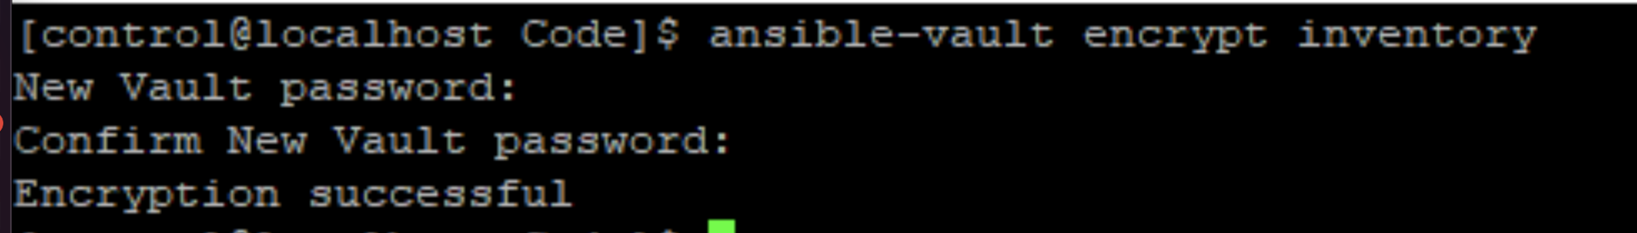
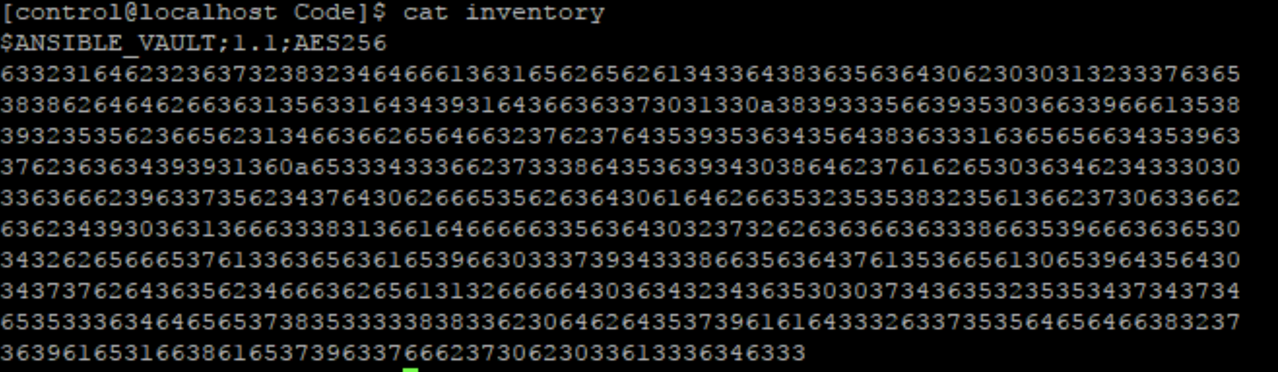
Ansible Vault
To setup ansible vault encryption for inventory
ansible-vault encrypt inventory
Below you can see the file is encrypted

Slide 6
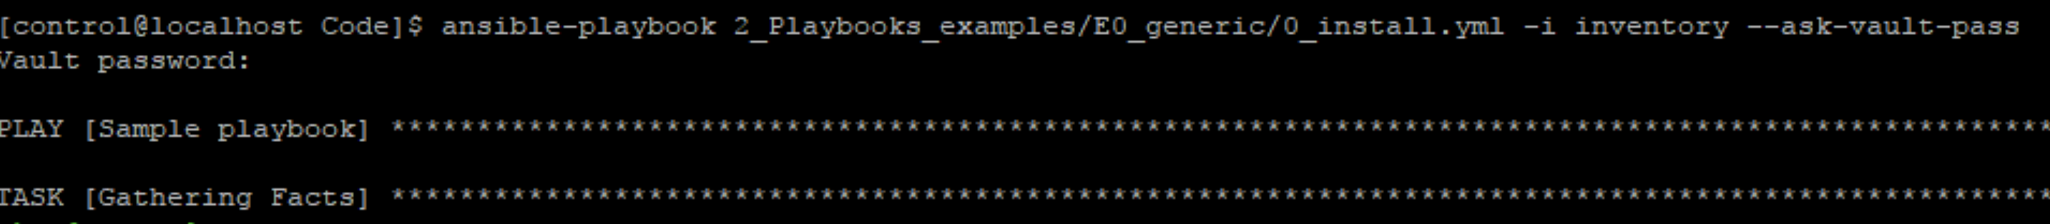
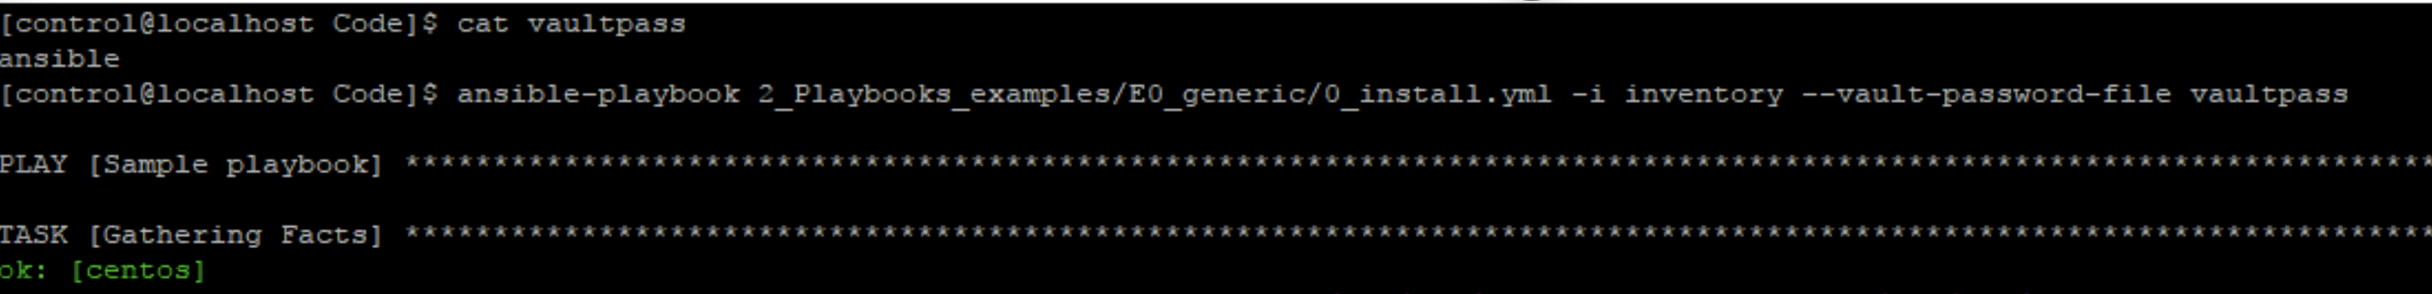
Cont.
To run a playbook by decrypting inventory using vault password.
ansible-playbook file.yml –i inventory --ask-vault-pass
To run a playbook using vault password saved in a file.
ansible-playbook file.yml –i inventory --vault-password-file vaultpass
To run a playbook using vault password generated using a script
ansible-playbook file.yml –i inventory --vault-password-file vaultpass.py

Slide 7

End of this topic !
Any questions?

